Slide 1
The Homeless Veterans’ Reintegration Program & Job Corps’ Scholars Grant Program
US Department of Labor, Employment and Training Administration
Office of Job Corps
April 6, 2021

Slide 2
Program Overview
Awarded in April 2020, officially launched in September 2020
Period of Performance (POP) – 39 months
Approximately $24 million awarded to 26 grantees – public colleges and universities
Each grantee must serve at least 80 Job Corps eligible youth during the POP
Grantees must provide the following services under the grant:
  Up to 12 months of career technical training
  Up to 12 months of career and personal counseling
  Up to 12 months of employment counseling
Desired Program Outcomes:
  2,000 Job Corps-eligible youth served within a POP of 39 months.
  Job Corps Scholars students secure any/all of the following: 1) job, 2) enter an apprenticeship program, or 3) join the armed services.

Slide 3
List of Awardees
California: Kern Community College District
Florida: Broward College, Palm Beach State College, and Northwest Florida State College
Georgia: Atlanta Technical College
Iowa: Indian Hills Community College and Des Moines Area Community College
Kentucky: Bluegrass Community and Technical College
Louisiana: Southern University at Shreveport
Michigan: Grand Rapids Community College and C.S. Mott Community College
Missouri: St. Louis Community College, and Community College District of Central Southwest Missouri
New York: Mohawk Valley Community College and Research Foundation of City University of New York obo Kingsborough Community College
North Carolina: Central Carolina Community College, Winston-Salem State University, and Vance Granville Community College
Ohio: Terra State Community College and Lorain County Community College District
Oregon: Chemeketa Community College District and Clackamas Community College
Texas: Lee College and El Paso County Community College
Washington: Skagit Valley College
West Virginia: Blue Ridge Community and Technical College

Slide 4
Eligibility Criteria for Job Corps Eligible Youth
Number | Job Corps Eligibility Criteria
1 | U.S. Citizen/Legal Resident/Deferred Action Status
2 | Age
3 | Low Income
4 | Barriers to Education and Employment
5 | Selective Service Registration
6 | Education and Training Needs
7 | Group Participation
7 a) | Interference with other Students’ Participation
7 b) | Maintenance of Sound Discipline and Positive Center Culture
7 c) | Community Relations
8 | Understanding and Agreeing to Comply with the Rules
9 | Disqualifying Convictions
10 | Court Involvement and/or Agency Supervision
11 | Child Care
12 | Authorization for Use and Disclosure of Health Information
13 | Parental Consent

Slide 5
Program Flexibilities
Cohort Design
  Grantees may enroll students on a rolling basis to serve a total of 80 Job Corps eligible youth. Grantees are not required to wait until they have a cohort of 40 applicants until they can be enrolled, but cohort sizes may not be smaller than 5 applicants. This guidance provides flexibility to allow grantees to serve to pending Job Corps eligible youth but does not remove the requirement to maintain a cohort design.
Co-enrollment
  Grantees may co-enroll across ETA grants and other federal and state programs including, but not limited to WIOA youth, re-entry, pre-apprenticeship and apprenticeship grants, contracts, and cooperative agreements funded by ETA. Co-enrollment is disallowed with Job Corps programs, including center enrollment or enrollment in any other Job Corps demonstration projects to minimize duplication of efforts.
Leveraged Resources
  Leveraged resources include non-grant funds that help the grantee carry out the program (e.g., in-kind contributions that support administrative staff not funded by the grant). They also include those resources outside of enrollment in another program that can assist individual participants (e.g., scholarships).
Disability Waiver ~ upper age limit waiver for persons disabilities
Recruitment of Veterans
50% of Participants Allowable Outside of Zip Code
LMI Informed Program Offerings (colleges offer their CTT available programs)

Slide 6
Resources
Job Corps Scholars Program Website - https://www.dol.gov/agencies/eta/jobcorps/job-corps-scholars
Program Manager for Job Corps Scholars– Michelle Mills, mills.michelle.v@dol.gov
Federal Project Officer for Job Corps Scholars – Angela Dayton, dayton.angela@dol.gov
Job Corps Scholars Mailbox to submit inquiries – JobCorpsScholars@dol.gov

Slide 7
Introduction: Homeless veterans’ reintegration program
April 6th, 2021
Notes:
NOTE:
To change the image on this slide, select the picture and delete it. Then click the Pictures icon in the placeholder to insert your own image.

Slide 8
Finding an HVRP Grantee near you

Slide 9
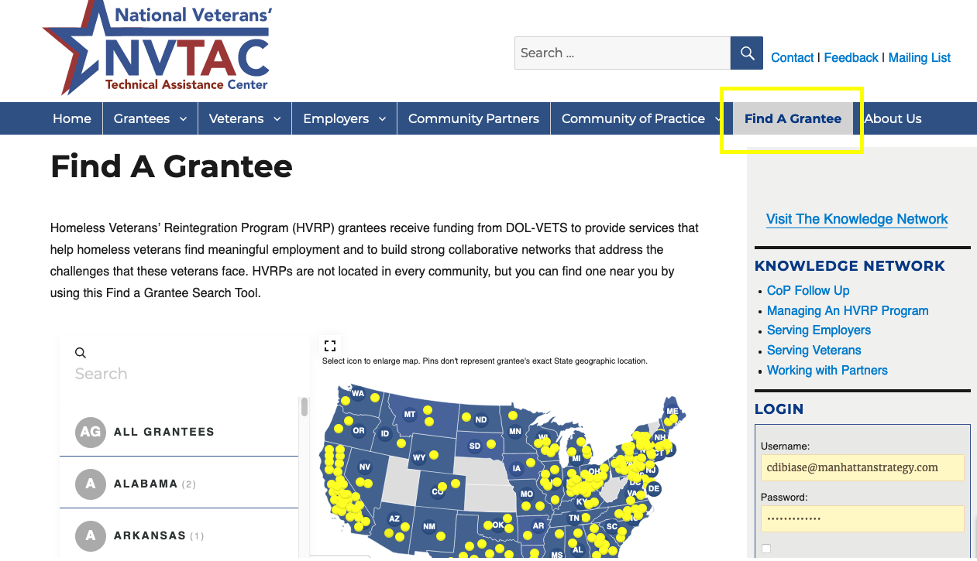
NVTAC.org/find-a-grantee/

Slide 10
Introduction to HVRP

Slide 11
What is HVRP?
The Homeless Veterans’ Reintegration Program (HVRP), The Homeless Female Veterans’ and Homeless Veterans’ with Families Program (HFVVWF), and The Incarcerated Veterans’ Transition Program (IVTP)
Competitive grant administered by the Department of Labor, Veterans’ Employment and Training Service (DOL-VETS)
Authorized under 38 U.S.C Sections 2021, 2021(a) and 2023
Notes:
The Homeless Veterans’ Reintegration Program (HVRP) The Homeless Female Veterans’ and Homeless Veterans’ with Families Program (HFVVWF), and The Incarcerated Veterans’ Transition Program (IVTP), collectively referred to as HVRP is a competitive grant administered by the Department of Labor, Veterans’ Employment and Training Service (DOL-VETS).

Slide 12
HVRP Objectives
The purpose of the Program is:
  To provide services to reintegrate homeless veterans into the labor force by placing them into family-sustaining employment; and
  To stimulate the development of effective service delivery systems that will address the complex problems facing homeless veterans.
Family-sustaining employment is defined as paid employment,
in line with the homeless veteran’s aspirations, talents, and abilities that ideally provides at least the minimum income necessary for a worker to meet his or her basic financial needs.
Notes:
HVRP has two main objectives:
To provide services to reintegrate homeless veterans into the labor force by placing them into meaningful employment, and
To stimulate the development of effective service delivery systems that will address the complex problems facing homeless veterans.
What is family-sustaining employment? Click on “family-sustaining” to reveal text box
In the ideal situation, the employment will provide, at a minimum, the income necessary for the veteran to meet his or her basic financial needs. However, given the population that HVRP serves, getting to that minimum level of income may be a process that occurs over time.

Slide 13
HVRP
HVRP is the only competitive federal grant program focused exclusively on employment for veterans at-risk of or experiencing homelessness
HVRP is a piece of – and a partner to - two much larger systems:
  Homelessness
  Workforce
Coordination between the two systems is essential to successful service delivery.

Slide 14
HVRP and Homelessness
Homeless System*:
Homelessness
HV Employment
HVRP
Veterans
Homeless System | HUD CoCs | $2.283 billion
Veteran-Specific | SSVF, GPD, HUD-VASH | $566 million
Homeless Veteran Employment** | VHA Employment (HVCES, CWT) | $75.2 million
HVRP | HVRP | $50 million
*approximate funding for FY2019
**does not include funding for VBA programs

Slide 15
HVRP Services and Approach
Veteran Outreach
Assessment
Case Management/IEPs
Partnership Development and Shared Case Management/Service Delivery
Addressing Barriers to Careers
  Training
  Supportive Services
Job Development
Employer Engagement
Employment Adjustment Services (i.e. Retention)

Slide 16
Eligible Participants
Veterans served by HVRP include:
Homeless veterans.
Veterans who are “at risk” of homelessness in the next 60 days.
Veterans participating in HUD-VASH or Tribal HUD-VASH.
…veterans receiving assistance under the Native American Housing Assistance and Self-Determination Act of 1996.
Veterans in transition from incarceration.
Veterans participating in VA’s Rapid Rehousing and Prevention program.

Slide 17
Contact Information
Cori Di Biase - Dallas Region
Manhattan Strategy Group
cdibiase@manhattanstrategy.com
Cindy Borden - Atlanta, San Francisco and Philadelphia Regions
NCHV
cborden@nchv.org
Nicole LaCorte-Klein - Boston and Chicago Regions
Atlas Research
nlacorteklein@atlasresearch.us

